Slide 1
ARTIFICIAL INTELLIGENCE
TOPIC : NLP
SUBMITTED TO : SIR USMAN
SUBMITTED BY : ABDUL HANAN AFZAL

Slide 2
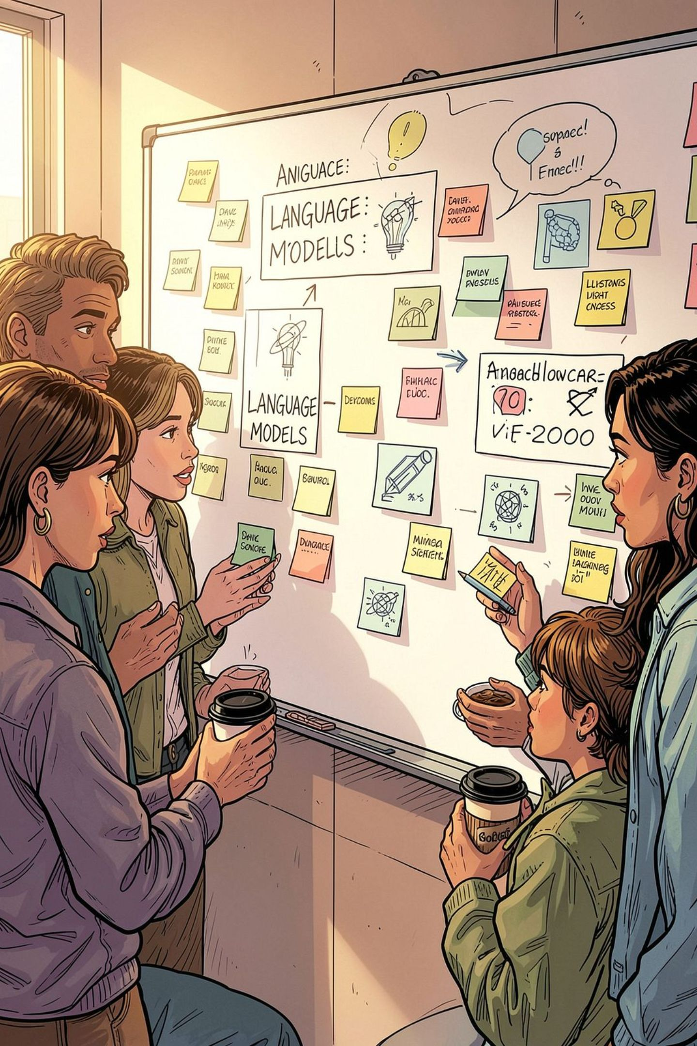
What NLP Is (and why it’s hard)
NLP enables computers to understand, generate and interact with human language. Challenges arise from ambiguity (multiple meanings), variation (dialects, slang), and noisy inputs (typos, OCR errors).
Ambiguity
Words and phrases often have more than one interpretation depending on context.
Variation
Dialects, synonyms and register create diverse surface forms for the same idea.
Noisy Input
Speech recognition errors, misspellings and corrupted data complicate processing.

Slide 3
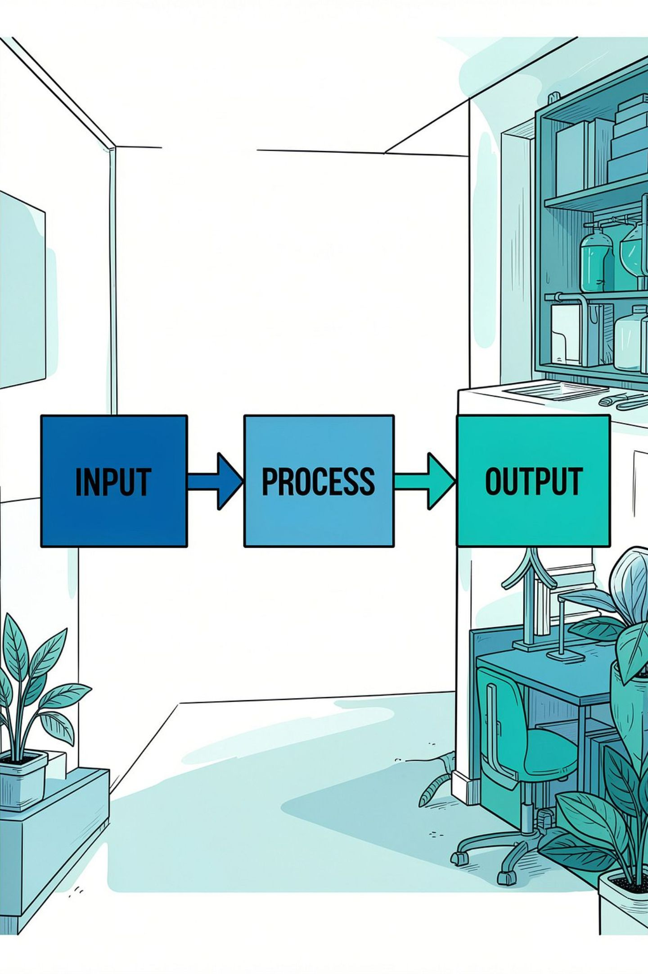
The NLP system view: input → process → output
Think of NLP as a function f: X → Y where X and/or Y are language. Typical outputs:
Classes — e.g., sentiment, spam
Structured representations — parses, entities, relations
Generated text — translation, summaries, replies

Slide 4
The core steps of NLP (the pipeline)
Preprocessing readies raw text for modelling. Common steps:
Tokenization
Normalization
Lemmatization & Stemming
Split text into words/subwords for downstream features.
Lowercasing, punctuation handling, Unicode normalisation.
Reduce inflected forms to their base for better generalisation.
POS tagging & WSD
Error correction
Part-of-speech and word-sense disambiguation add linguistic signal.
Spell-check and noisy-channel fixes improve data quality.
These prepare data for classification, extraction, similarity measures, or generation.

Slide 5

Step-by-step example: sentiment classification
Goal: label a review as positive / neutral / negative. A practical pipeline:
Data collection & labelling — gather representative reviews
Preprocessing — tokenise, normalise, handle emoticons
Feature extraction — bag-of-words, embeddings, sentiment lexicons
Modeling — choose classifier or neural model, tune hyperparameters
Evaluation & deployment — accuracy, F1, monitoring drift

Slide 6
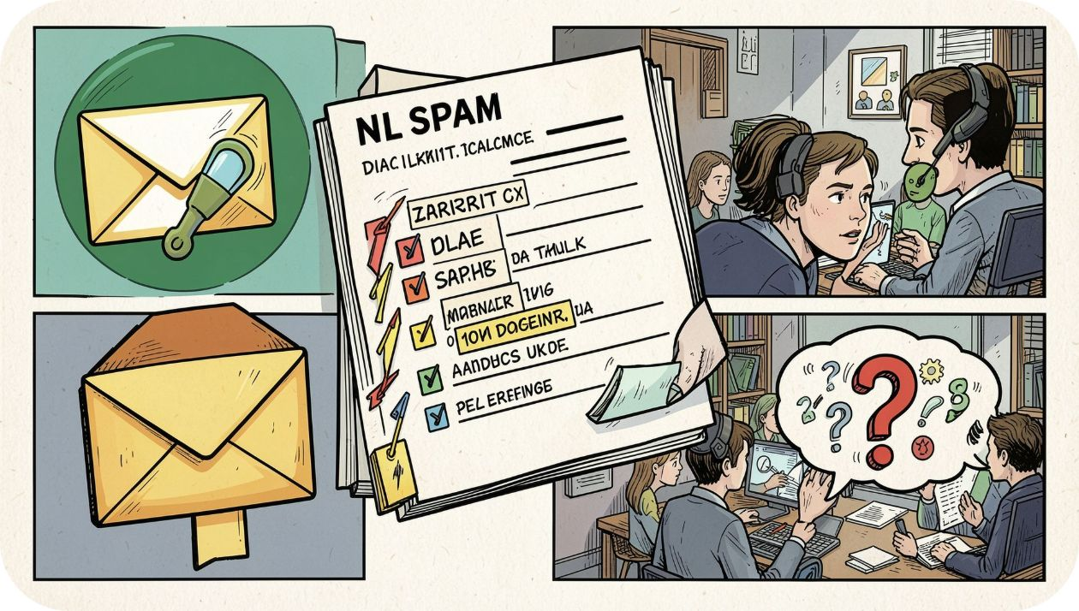
Example tasks you’ll recognise instantly
Short descriptions of common NLP applications:
Classification — spam detection, intent, urgency
Retrieval & QA — find passages or generate grounded answers
NER & Coreference — identify people, places and link mentions
Relation extraction — build structured facts and knowledge graphs
Generation — MT, summarisation, conversational agents

Slide 7
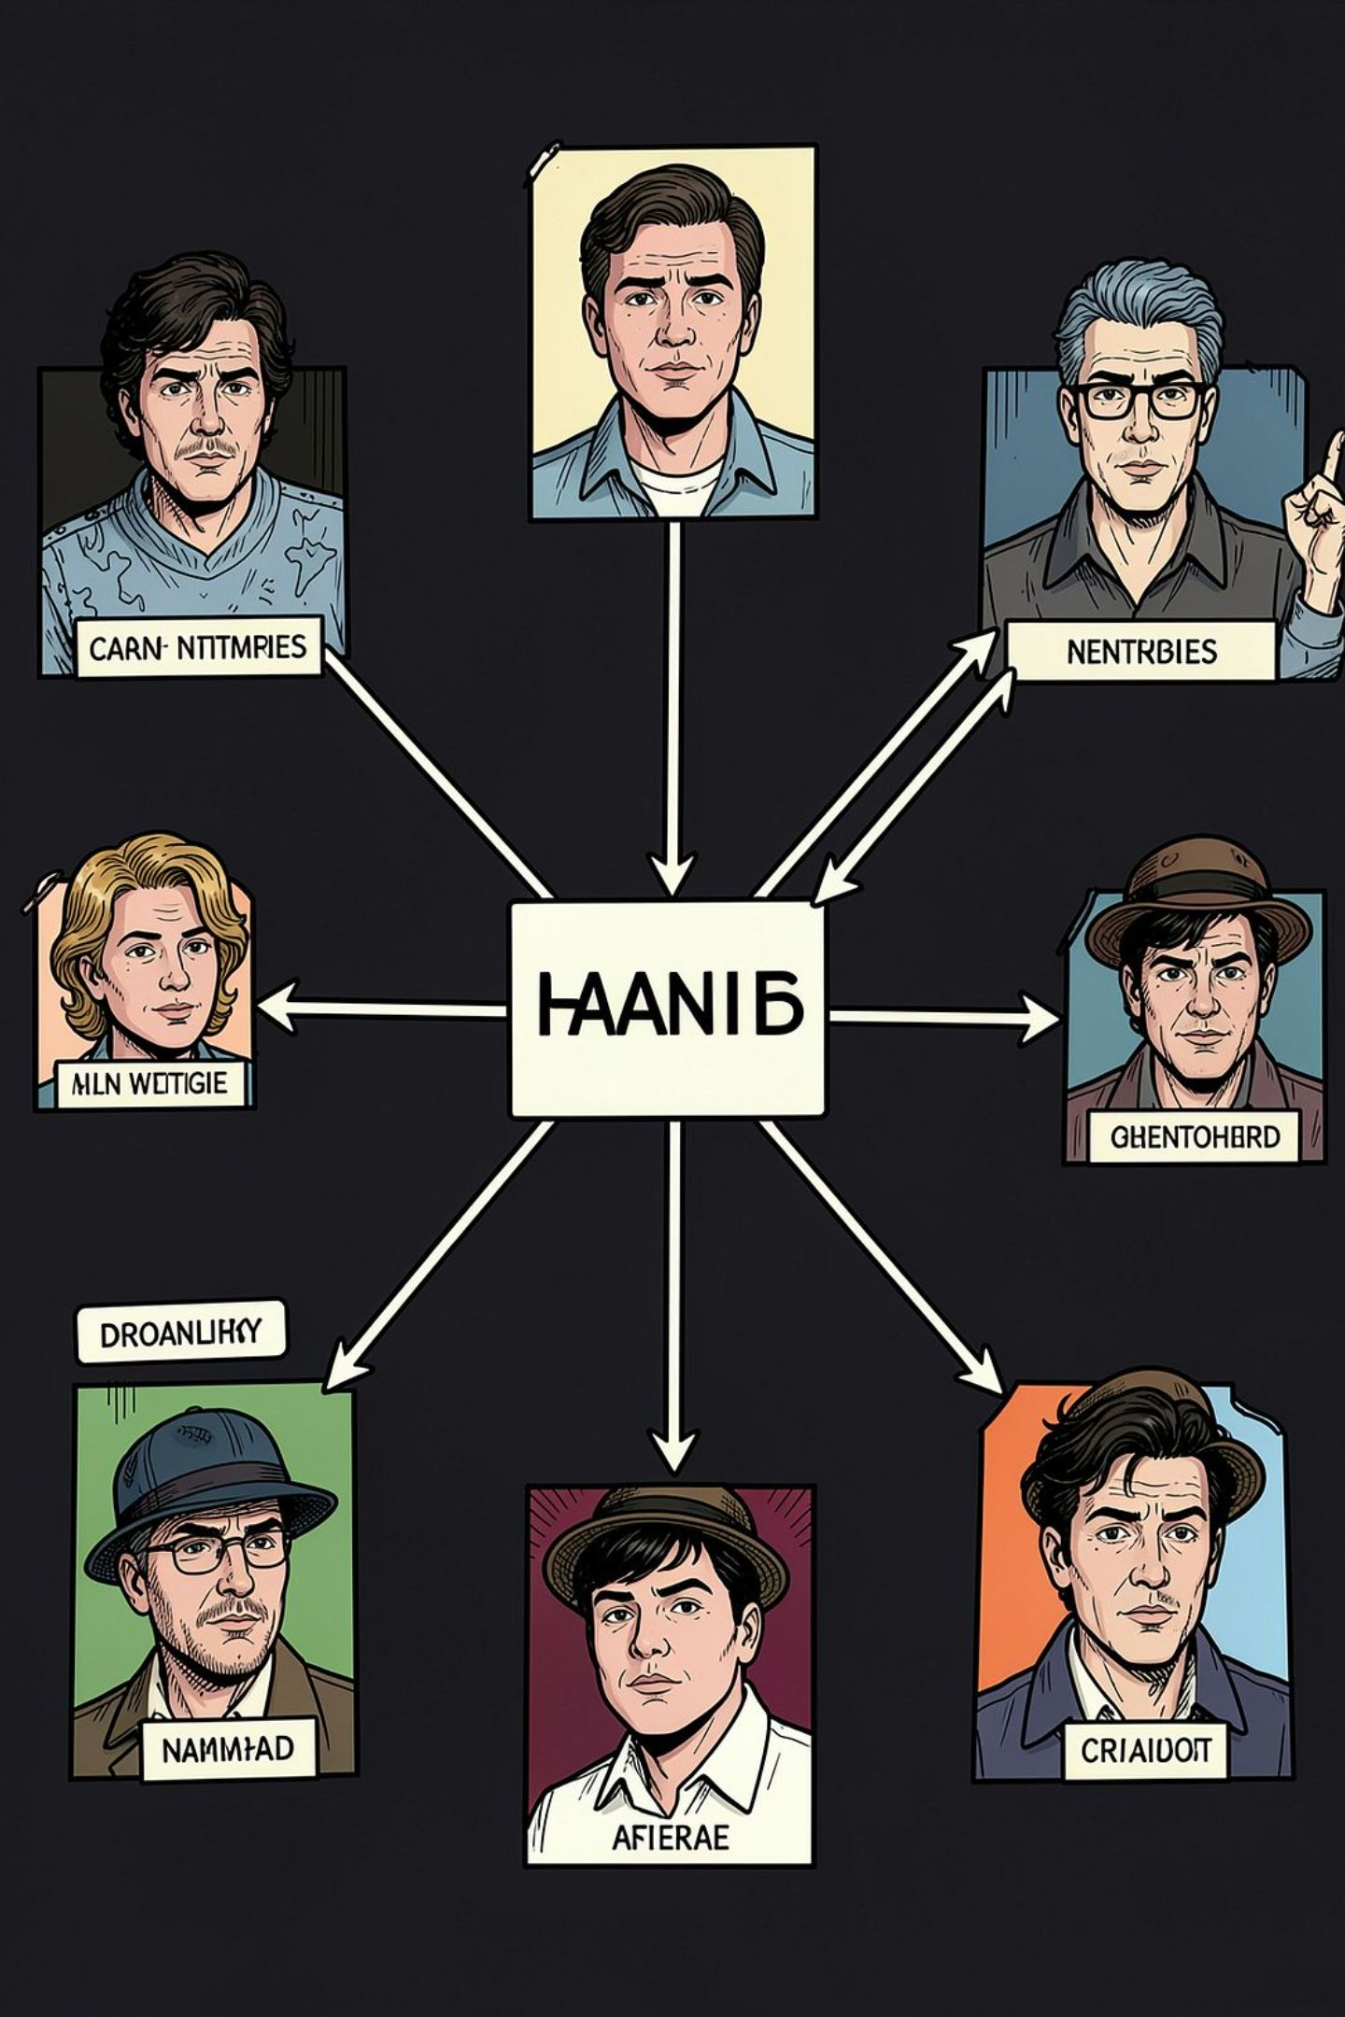
Entities & relationships: turning text into structure
Systems convert raw mentions into nodes and edges that power search and inference.
Named Entity Recognition
Coreference Resolution
Relation Extraction
Detect people, organisations, locations and domain entities.
Cluster mentions that refer to the same real-world entity.
Identify facts and build knowledge graphs for downstream queries.

Slide 8
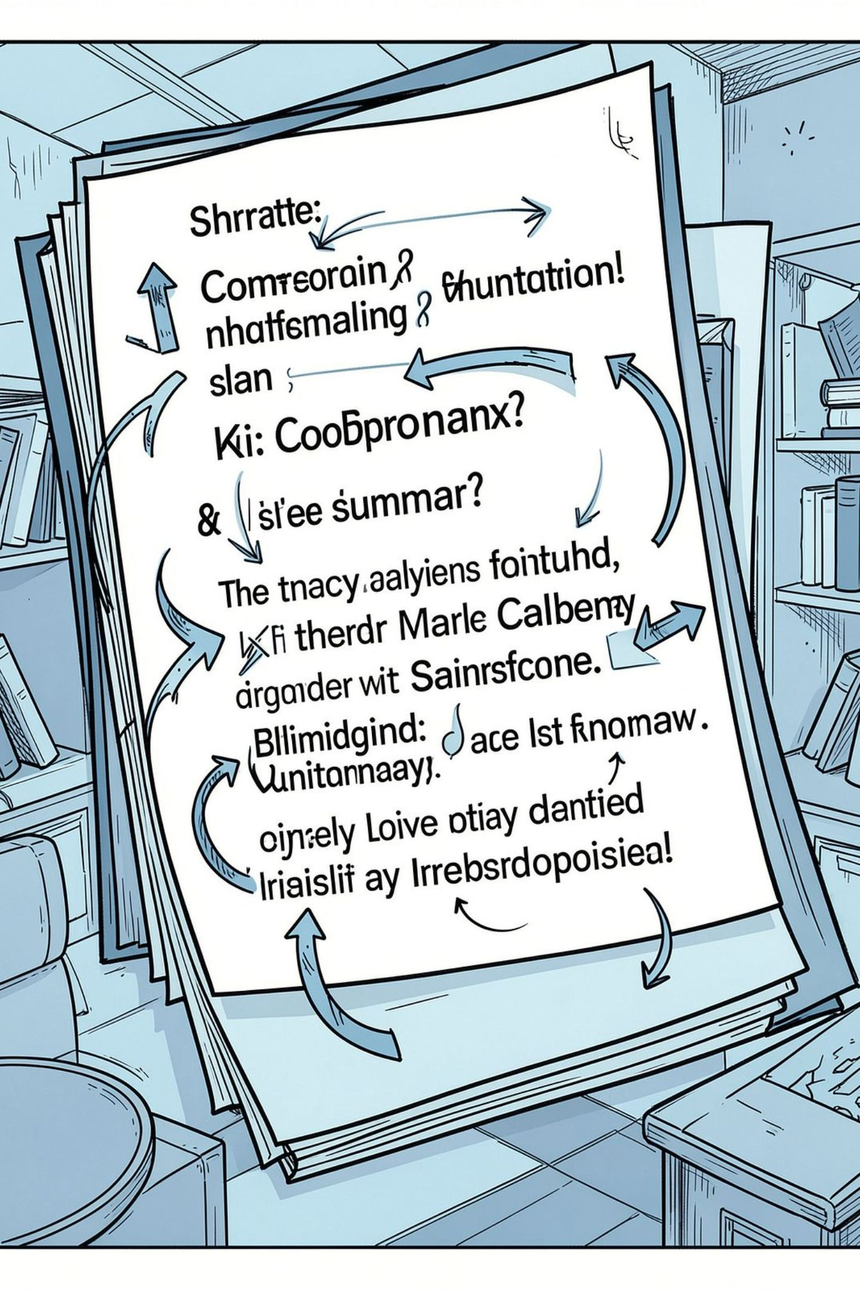
Text generation: translation to summarisation
Generation relies on learned representations that model sequences and context.
Machine Translation
Map sentences between languages preserving meaning and fluency.
Summarisation
Condense documents (extractive or abstractive) while keeping key points.
Dialogue & Completion
Produce coherent replies and continue text in conversational settings.

Slide 9
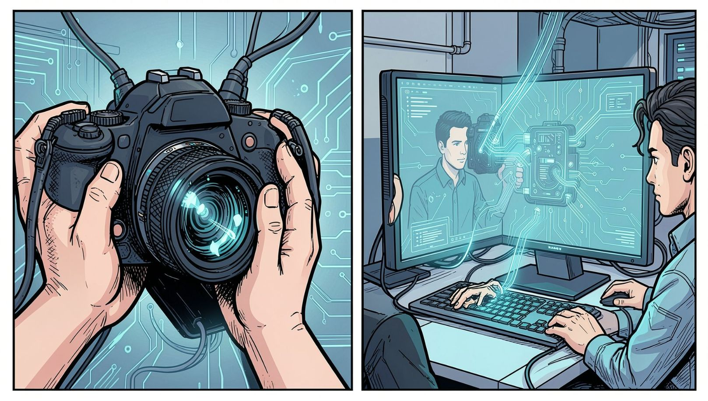
Image processing: pipelines that mirror NLP
Vision pipelines follow a parallel structure: acquire → represent → transform → interpret.
Multimodal tasks (e.g., image captioning) connect image representations to language models for joint understanding.
Acquire
Represent
Capture images or video (sensors, sampling, formats).
Pixel arrays, feature maps, and learned embeddings.
Transform
Interpret
Filtering, augmentation, detection and segmentation.
Classification, captioning, object relations, multimodal reasoning.

Slide 10
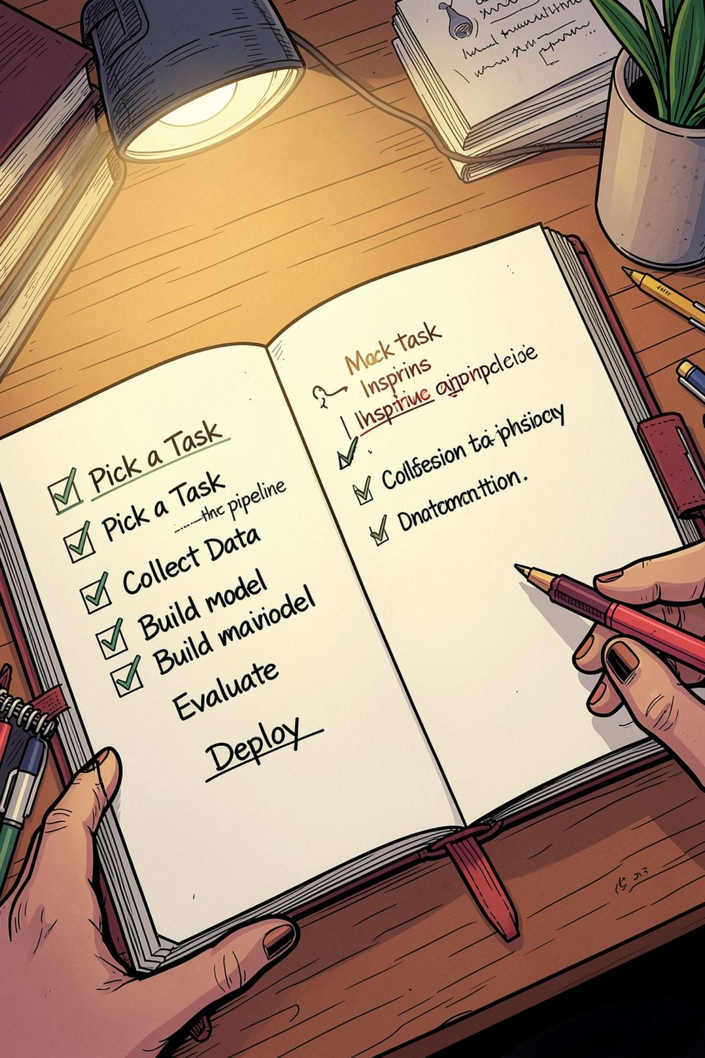

Conclusion & Next steps
The unifying idea: whether text or images, systems convert messy inputs into structured representations that support decisions and applications. Recommended next steps:
Choose one concrete task (sentiment, NER, summarisation, or captioning)
Map the end-to-end pipeline: data → preprocess → model → evaluate
Prototype quickly and monitor performance in real data
CLO2: Understand core pipelines. CLO5: Apply pipelines to a specific task end-to-end.

